Slide 1
Selecting a Topic
Dr Denise Lakay
10 February 2026

Slide 2
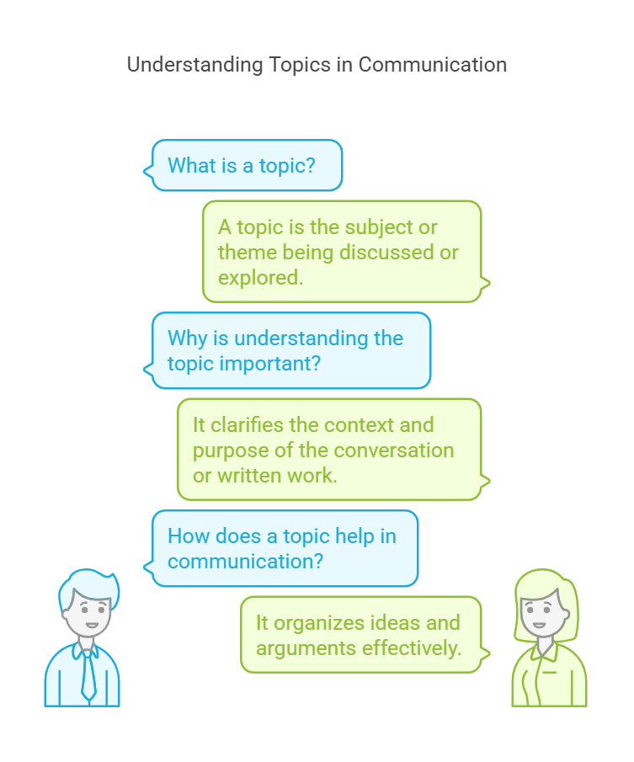
What is a topic?

Slide 3
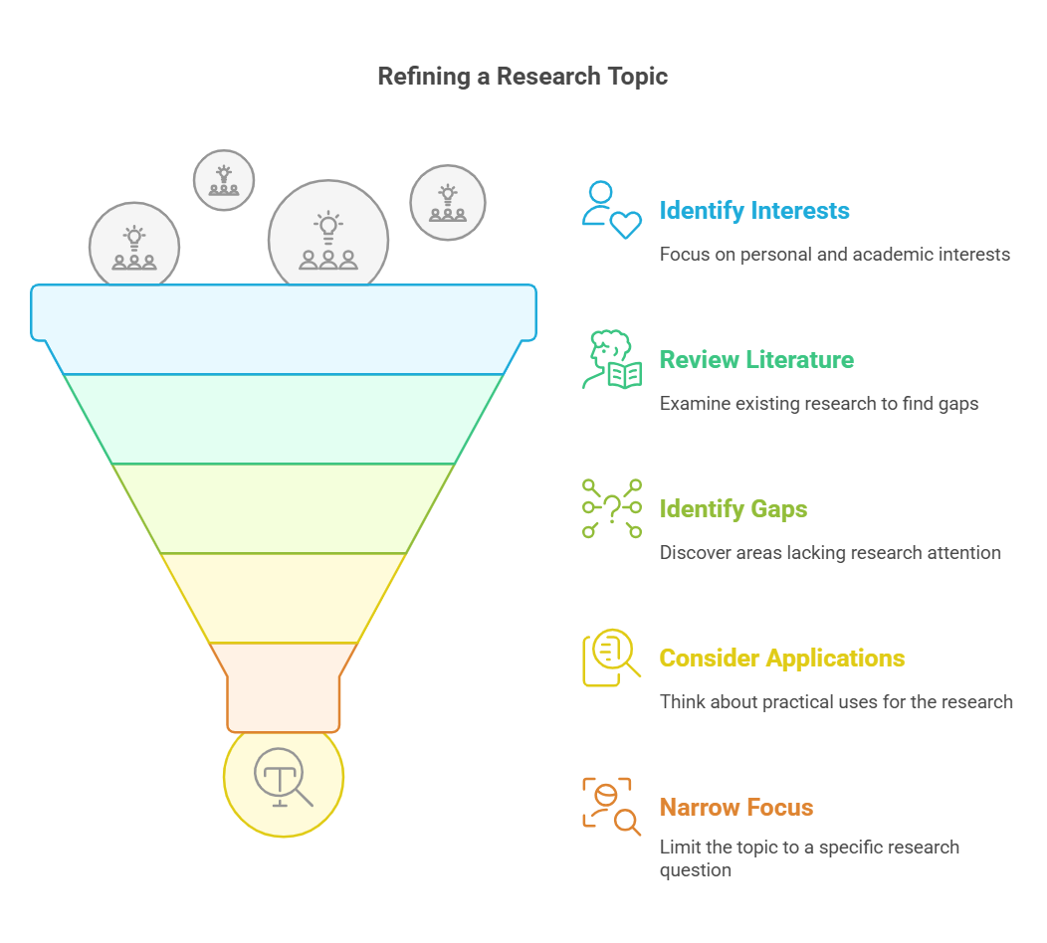
Searching for a topic

Slide 4

Understanding your interest

Slide 5
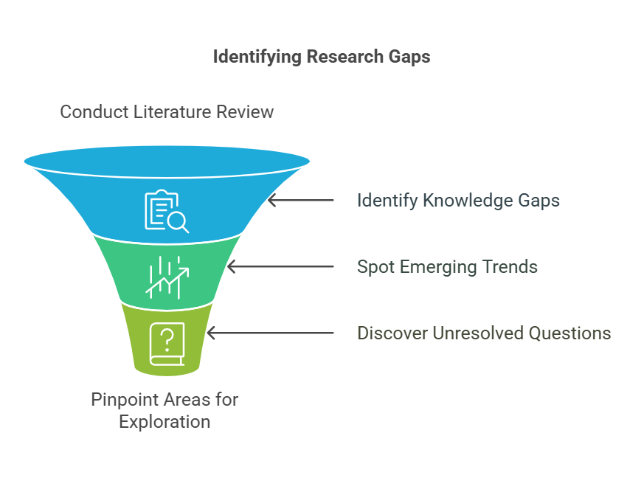
Reviewing Existing Literature

Slide 6
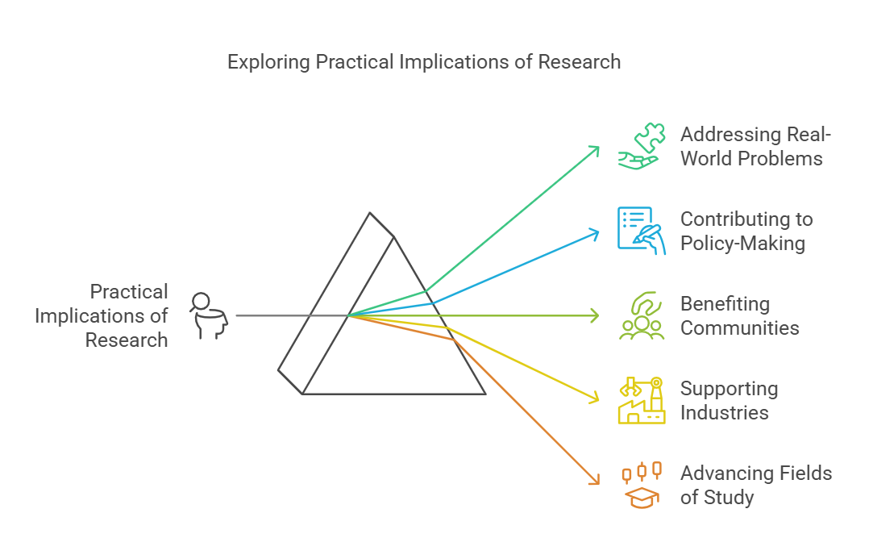
Practical implications of research

Slide 7
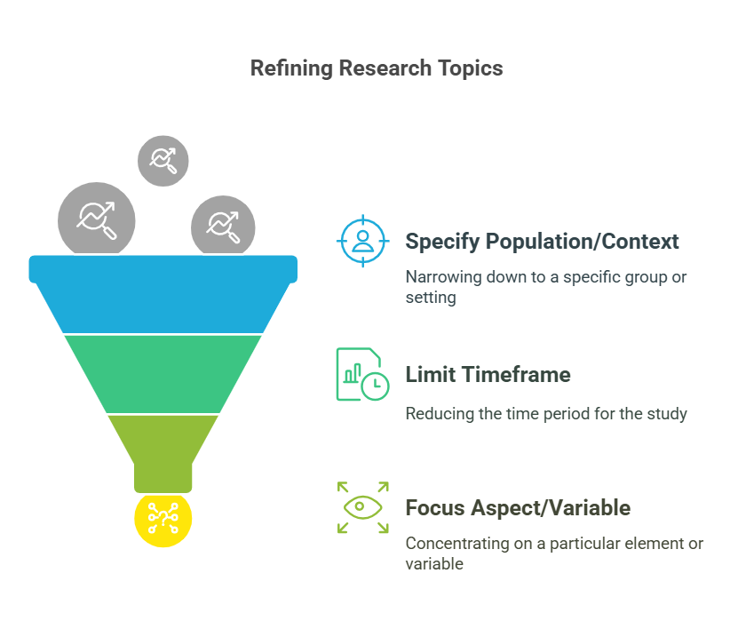
Narrowing your topic

Slide 8
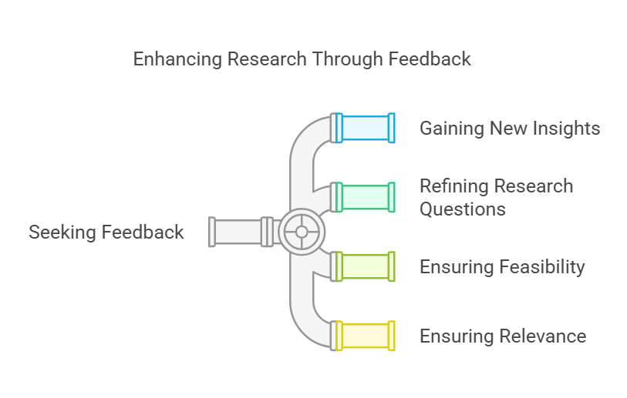
Looking for Feedback

Slide 9

Importance of a good topic

Slide 10
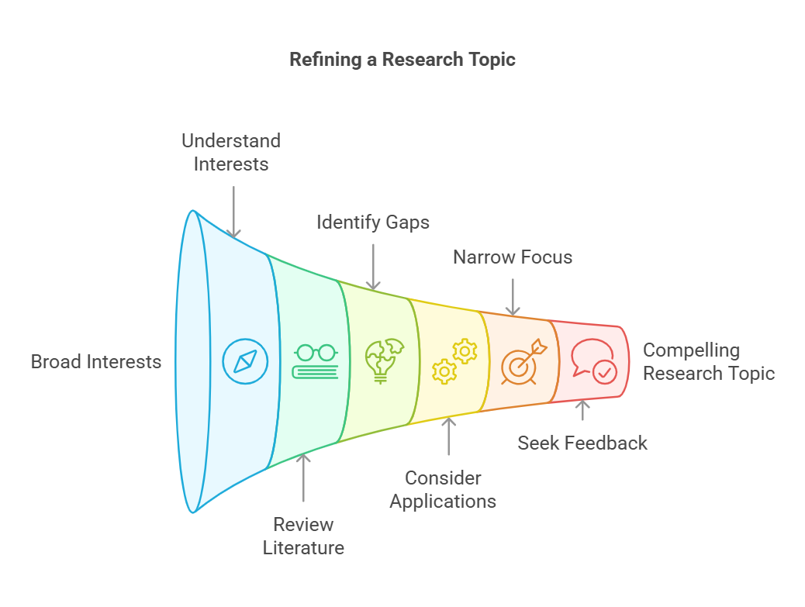
Conclude

Slide 11
Difference between a Topic and a title
Characteristics of Topic
Characteristics of Title
Broad and General: Topics are typically broad and encompass a wide range of information.
Subject of Exploration: It's the subject you intend to investigate, analyze, or discuss.
Starting Point: It serves as the initial point of departure for your writing process.
Descriptive: It describes what your writing is about in a general sense.
Specific and Concise: Titles are specific and to the point, often summarizing the main argument or focus.
Attention-Grabbing: They aim to capture the reader's interest and encourage them to read further.
Reflective of Content: They accurately represent the content of the writing.
Persuasive: They persuade the reader that the content is worth their time.

Slide 12


